Slide 1
LIBRARY MANAGEMENT SYSTEM

Slide 2
INTRODUCTION:
A Library Management System (LMS) is a software application designed to manage and automate the daily operations of a library. It helps in maintaining records of books, authors, users, and transactions in an organized and efficient manner. The system reduces manual work and improves accuracy, accessibility, and data security.
This project is developed using Spring Boot for the backend and HTML, CSS, and JavaScript for the frontend. It allows users to perform essential library operations such as adding new books, viewing the list of available books, updating book details, and deleting records. A secure login system is implemented to ensure that only authorized users can access the library features.
The Library Management System provides a user-friendly interface and ensures smooth interaction between the frontend and backend. By digitizing library operations, the system saves time, minimizes errors, and enhances overall efficiency.

Slide 3
ABSTRACT:
The Library Management System is a web-based application designed to automate and simplify the management of library operations. The system replaces traditional manual record-keeping with a digital solution that ensures efficiency, accuracy, and easy access to information. It allows administrators to manage book details such as title, author, and price through a centralized platform.
This application is developed using Spring Boot for the backend and HTML, CSS, and JavaScript for the frontend, with MySQL used for data storage. A secure login mechanism is implemented to restrict access to authorized users. The system supports essential operations including adding, viewing, updating, and deleting book records.
By providing a user-friendly interface and a robust backend architecture, the Library Management System reduces workload, minimizes errors, and improves data management. The project demonstrates how modern web technologies can be effectively used to build a reliable and scalable library automation solution.

Slide 4
What we are going to build:Client Requirements
1. Introduction:
The client requires a Library Management System (LMS) to efficiently manage books, users, and library operations. The system should reduce manual work, improve accuracy, and provide easy access to library data through a user-friendly interface.
2. Functional Requirements:
2.1 User Authentication
The system must provide a secure login page for authorized users.
Only authenticated users should be allowed to access library features.
Logout functionality must be available.
2.2 Book Management
The system must allow users to:
  Add new books with Book Name, Author Name, and Price
  View all available books in a tabular format
  Edit book details
  Delete books from the system
The book list should update dynamically after each operation.
2.3 Book Display:
Books must be displayed in a clear, readable table.
Each row should include Edit and Delete actions.
The system should show updated data .

Slide 5
What we are going to build:Some Technical Terms
A web-based Library Management System developed using Spring Boot for backend services.
A RESTful API architecture to handle book-related operations (Add, View, Update, Delete).
A secure authentication module using Spring Security for user login and access control.
A MySQL relational database for persistent storage of book records.
A responsive frontend interface built with HTML, CSS, and JavaScript.
CRUD operations implemented for efficient book management.
MVC (Model–View–Controller) design pattern to ensure clean separation of concerns.
Client–server communication using HTTP requests with JSON data exchange.

Slide 6
What are the technologies and tools:
Backend Technologies
Java – Core programming language used for application logic.
Spring Boot – Framework for building stand-alone, production-ready backend applications.
Spring Data JPA (Hibernate) – For object–relational mapping and database operations.
Spring Security – For authentication and authorization (login functionality).
Frontend Technologies
HTML5 – Structure of the web pages.
CSS3 – Styling and layout of the user interface.
JavaScript – Client-side interactivity and dynamic content handling
Database
MySQL – Relational database used to store book and user data.
Tools & Development Environment
Spring Tool Suite (STS) / IntelliJ IDEA – IDE for Java and Spring Boot development.
Maven – Dependency management and project build tool.
Postman – API testing tool for REST endpoints.
Apache Tomcat (Embedded) – Application server used by Spring Boot.
Browser & Testing
Google Chrome – Browser used for frontend testing and debugging.

Slide 7
Software Requirements:
Backend Software
Java JDK 17 (or above) – Required to develop and run the Spring Boot application
Spring Boot Framework – Backend application framework
Spring Tool Suite (STS) / IntelliJ IDEA – Integrated Development Environment (IDE)
Maven – Dependency management and build tool
Frontend Software
Web Browser (Google Chrome / Mozilla Firefox) – To access and test the application
HTML5, CSS3, JavaScript – Frontend technologies (run inside browser)
Database Software
MySQL Server – Relational database for storing library data
MySQL Workbench – Database management and query execution tool
Security & Testing Tools
Spring Security – For login and authentication
Postman – API testing tool for REST services
Application Server
Embedded Apache Tomcat – Provided by Spring Boot for application deployment
Version Control (Optional)
Git – For source code management and version control

Slide 8
Project Modules:
1. User Authentication Module
2. Book Management Module
3. Book Listing Module
4. Search & Filter Module
5. Frontend User Interface Module
6. Backend Service Module
7. Database Management Module
8. API Integration Module

Slide 9
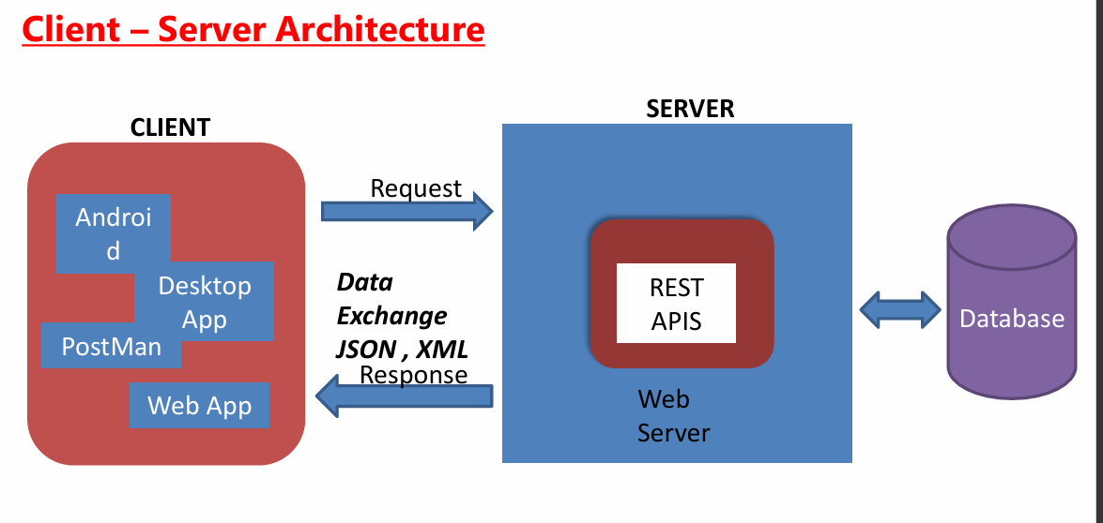
Client Server Architecture:

Slide 10
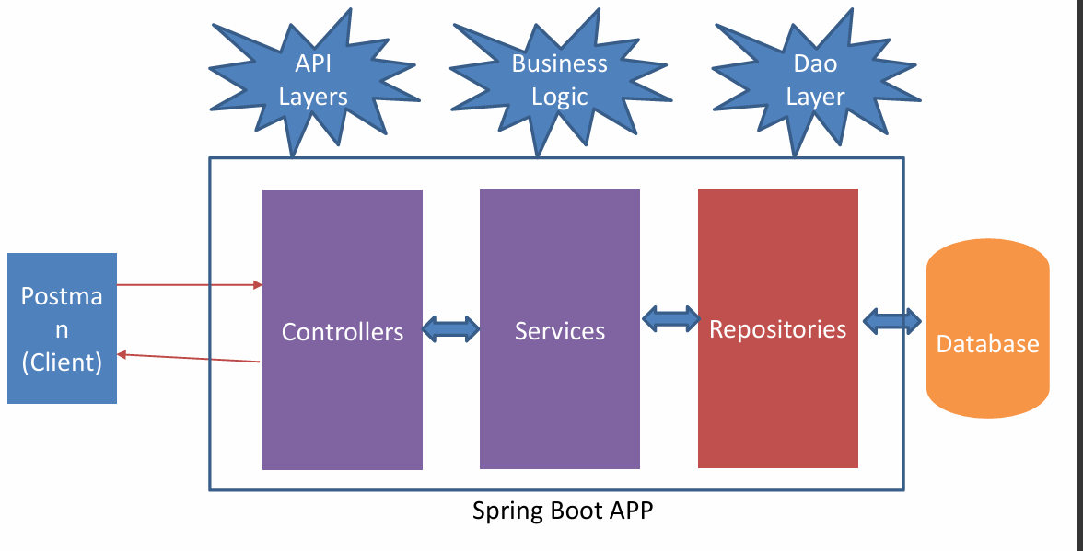
Spring Boot App:

Slide 11
Admin Module:
Admin Authentication
The admin module provides secure login functionality, ensuring that only authorized administrators can access the system and perform management operations.
Book Management
Admin can add new books, update existing book details such as title, author, and price, and remove books from the library collection when required.
User Management
The admin manages user accounts by creating, updating, or deleting user records and assigning appropriate roles and access permissions.
Transaction Monitoring
Admin can view and monitor all book transactions, including issue and return details, to ensure proper tracking of library activities.
System Maintenance
The admin oversees system operations such as data consistency, security configurations, and overall maintenance of the library management system.

Slide 12
Student Module:
Student Authentication
The student module provides login functionality that allows students to securely access the library system using their credentials.
Book Search and View
Students can search for books by title, author, or category and view detailed information such as availability and price.
Book Borrowing
Students can request or borrow available books from the library and view the list of books currently issued to them.
Return Management
The module allows students to return borrowed books and view return status and due dates.
Profile Management
Students can view and update their personal details and track their borrowing history within the system.

Slide 13
Company Module:
Company Profile Management
The company module maintains complete details of the organization responsible for managing the library system, including name, address, and contact information.
System Ownership and Administration
This module defines the company as the system owner, responsible for configuring system settings, managing users, and overseeing overall library operations.
Policy and Rule Management
The company can define library policies such as borrowing limits, fine rules, membership validity, and operating hours.
Data Security and Compliance
Ensures secure handling of library data, user information, and compliance with organizational or institutional standards.
Maintenance and Support Management
The company module supports system updates, bug fixes, backups, and technical support to ensure smooth and uninterrupted system operation.

Slide 14
Training Module:
User Training Management
This module provides training programs for librarians, administrators, and staff to understand system functionalities and workflows.
System Usage Guidance
Helps users learn how to perform daily operations such as book entry, issue/return processing, member management, and report generation.
Role-Based Training
Different training content is provided based on user roles like Admin, Librarian, and Staff to ensure efficient system usage.
Documentation and Tutorials
Includes user manuals, step-by-step guides, and video tutorials to support learning and reduce operational errors.
Skill Enhancement and Updates
Regular training updates are conducted whenever new features or system enhancements are introduced.

Slide 15
Placement Module:
Career Guidance Support
This module helps students and staff access information related to placement preparation, career guidance, and professional development resources available in the library.
Placement Resource Management
Manages books, journals, e-books, and digital materials related to aptitude tests, interview preparation, competitive exams, and technical skills.
Company Information Access
Provides details about recruiting companies, job roles, eligibility criteria, and placement-related documents for easy reference.
Training and Placement Coordination
Supports coordination between the library and placement cell by organizing training schedules, placement materials, and notices.
Digital Learning Support
Offers access to online learning resources, previous interview questions, and placement-oriented study materials.

Slide 16
DATA DICTIONARY

Slide 17

Tables Of Database:

Slide 18
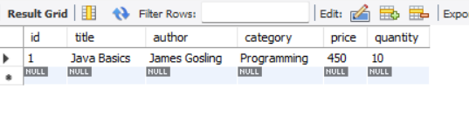
Show Table:

Slide 19
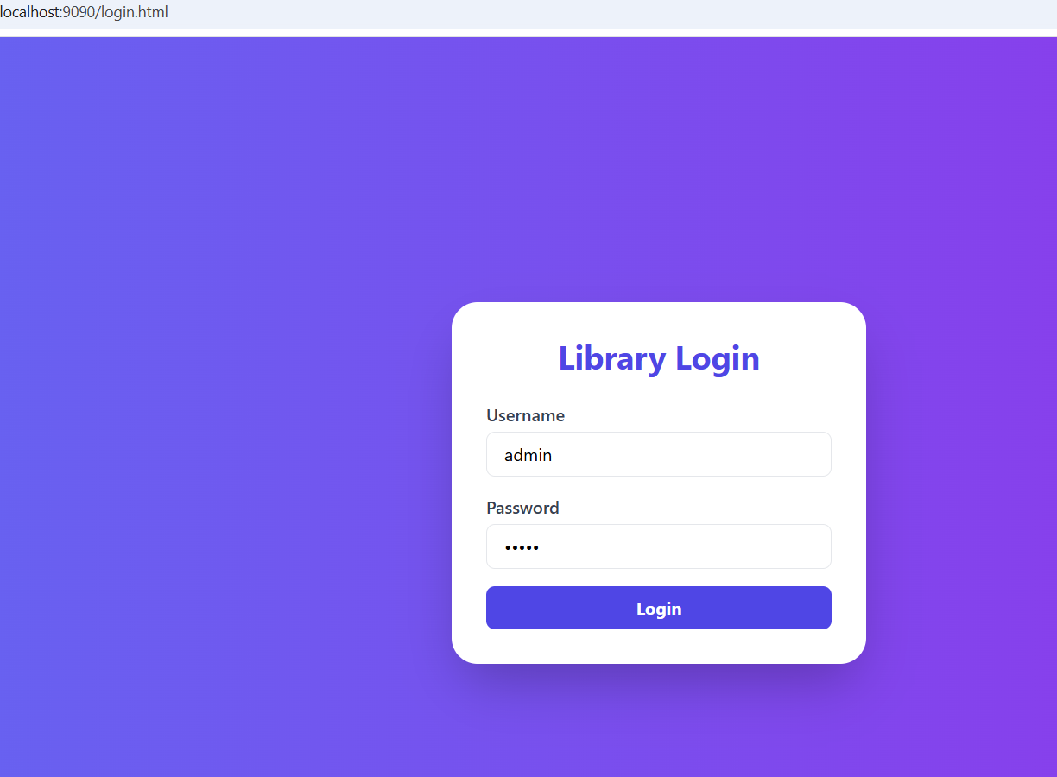
Localhost:9090/Login.html:

Slide 20
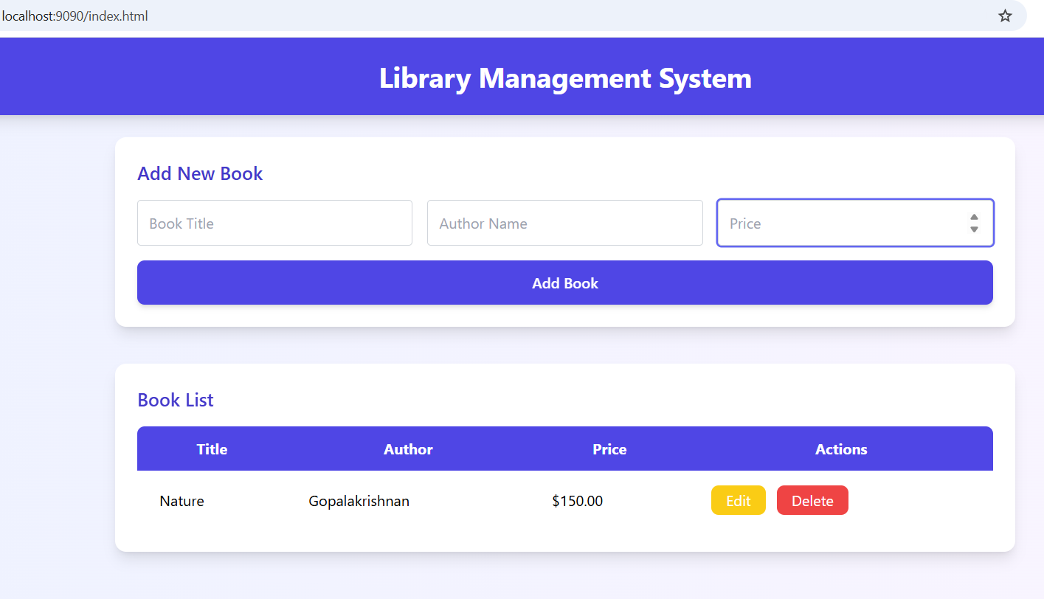
Localhost:9090/index.html

Slide 21
Video Links:
https://drive.google.com/file/d/1smHRCHZZvMvYO4VqSCRZQrkTmSlqh5fq/view?usp=sharing

Slide 22
Github Links:
https://github.com/Yazhini-246/css-box-model

